Slide 1
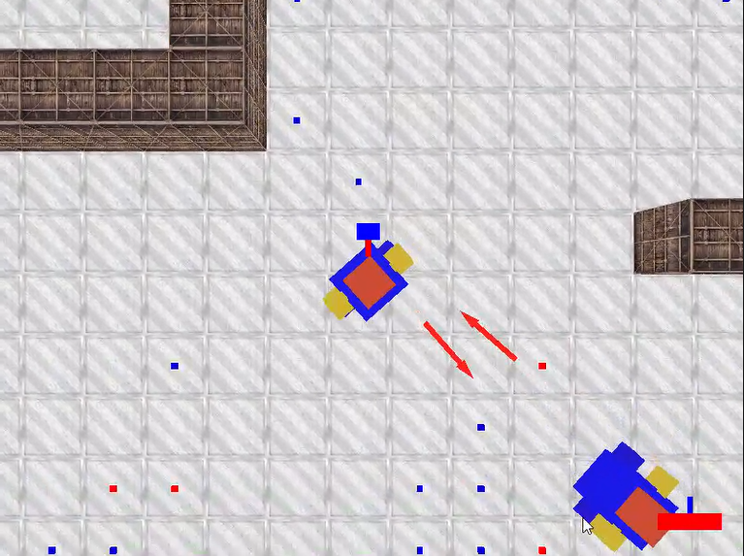
Archers battle
GROUP 8
GROUP MEMBER: Dan(Boyang) Liu, Yufei Huang, Yuan Huang

Slide 2

01
Problem Statement & Analysis
目录
02
Design
03
Implementation
04
Test

Slide 3




Problem statement & Analysis

Slide 4

Problem statement & Analysis
Generate a map
Implement random generation
of stars on the map
Recognize wall and stars
Collison detection
NPC
Create a walking NPC who can eat stars and shoot. And use multiple threads to improve the prefromance.
Control archer’s action
Path way--- keyboard
Direction of archery---mouse

Slide 5

2
Design

Slide 6
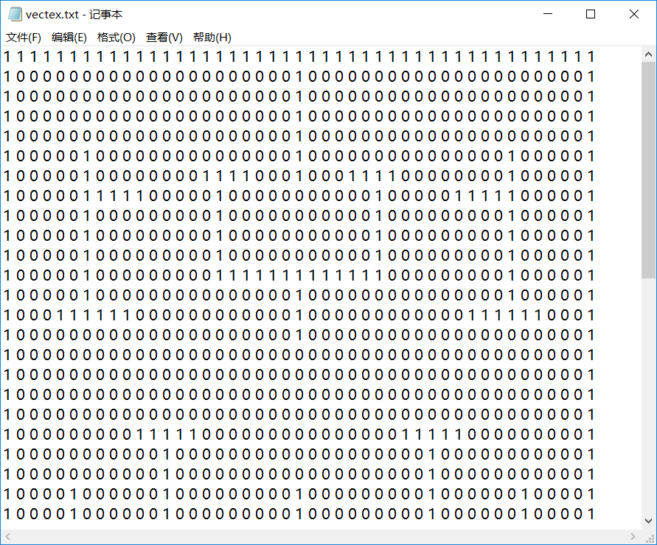
First it needs to generate a map. It uses a txt document to record the information, in this txt, 0 stands for the stay, 1 stands for the wall. That’s the thought, now it needs to design the reading
Design
Generate stars randomly

Slide 7
First, design our data type.
Decided to use class include the arguments needed.
Generate stars randomly
Design
class GameObject
{
public:
glm::vec3 Position, Size;
glm::mat4 Rotation;
GLfloat dt = 0.0f;
GLboolean Destroyed;
GLboolean Occupied = GL_FALSE;
GameObject();
GameObject(glm::vec3 pos, glm::vec3 size, glm::vec3 color = glm::vec3(1.0f) );
…
};
It will be also used later.
The types of the arguments use the overloading by OpenGL for the portability - “GL”
And the glm is the OpenGL Math.

Slide 8
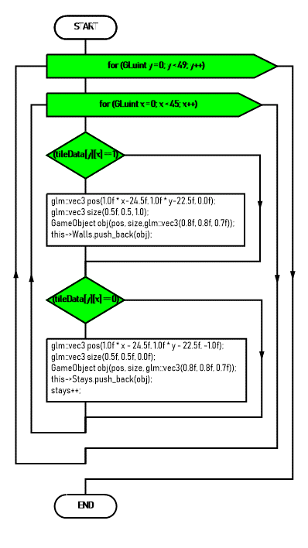
Design
Generate stars randomly
The flow chart to read the info. It’s the main idea, in implement it uses C++ stream.

Slide 9
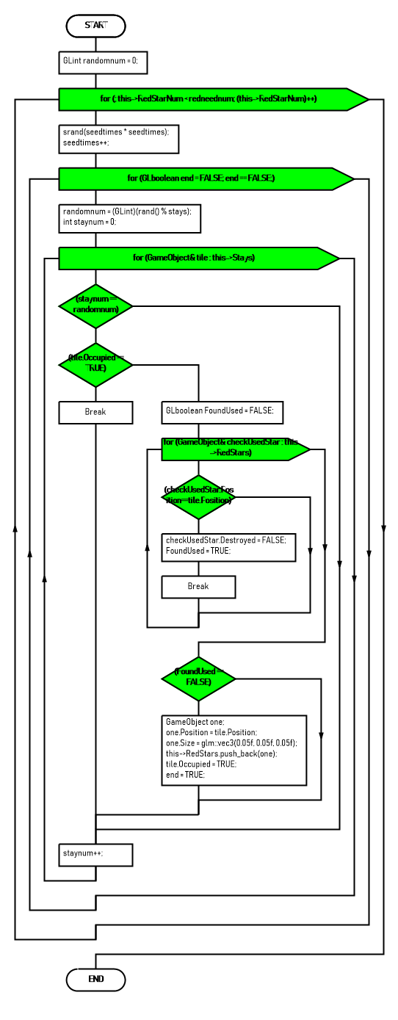
Design
Generate stars randomly

Slide 10
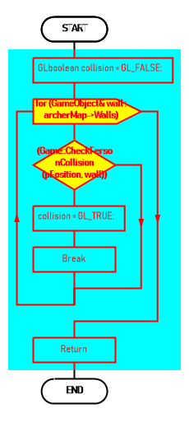
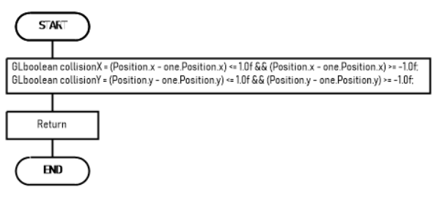
Design
Collison

Slide 11
Design
NPC
Search the nearest star
To create NPC looks intelligent and make this game more interesting, this project try to achieve finding and eating the stars on the map and shooting at other players automatically.
Main
Structure:
Use BFS to search the path
to reach the star
The shooting is easy, just to get the direction. Here interduces the path finding and walking:
Make archer walk along the path…(show you later)

Slide 12
Design
First, design our data type.
Use class include the arguments needed.
NPC
Running along the way
Class for Breadth First Search
class GameShootingObject
{
public:
glm::vec3 Position, Velocity, Direction = glm::vec3(1.0f);
GameObject Goal;//star
FindingPath findingPath;
std::vector<GameObject> Path;
GLboolean abletoshoot = GL_TRUE;
GLboolean walking = GL_FALSE;
GLfloat speed = 3.0f;
GLuint step = 1;
…
};
class GameObject
{
public:
glm::vec3 Position, Size;
glm::mat4 Rotation;
GLfloat dt = 0.0f;
GLboolean Destroyed;
GLboolean Occupied = GL_FALSE;
GameObject();
GameObject(glm::vec3 pos, glm::vec3 size, glm::vec3 color = glm::vec3(1.0f) );
…
};
class FindingPath
{
public:
std::vector<GameObject> openlist;
std::vector<GameObject> closedlist;
std::vector<GameObject> path;
GLint FindingPathValue;
GLvoid Init(std::vector<GameObject>);
std::vector<GameObject> FindingWay(GameObject goal, GameObject nowStay);
private:
std::vector<GameObject> stays;
GLboolean FindingNBH(GameObject now, GameObject goal);
GLvoid PrintfPath(GameObject goal);
GLboolean checkIfNear(GameObject one, GameObject two);
};

Slide 13
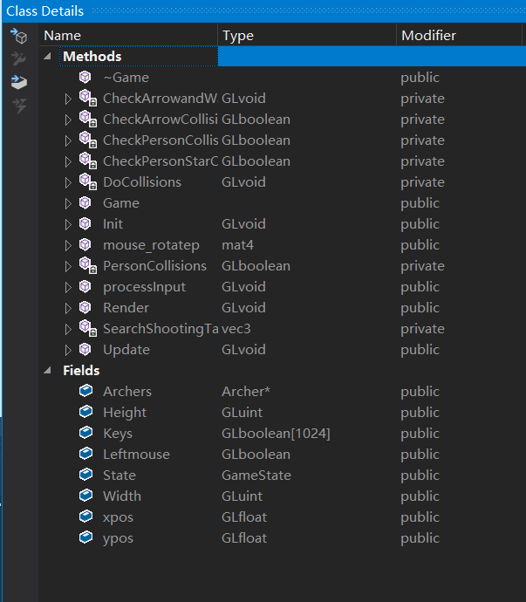
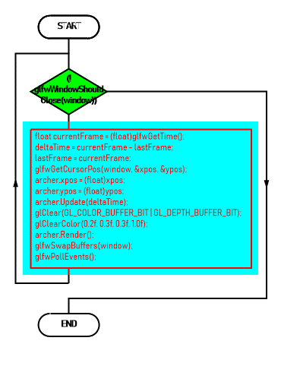
Design
In the rendering loop, we use a class called Game to manage this game. It concentrates the functions
NPC
Running along the way
The usage in main function.
The object of the Game class is called archer.

Slide 14
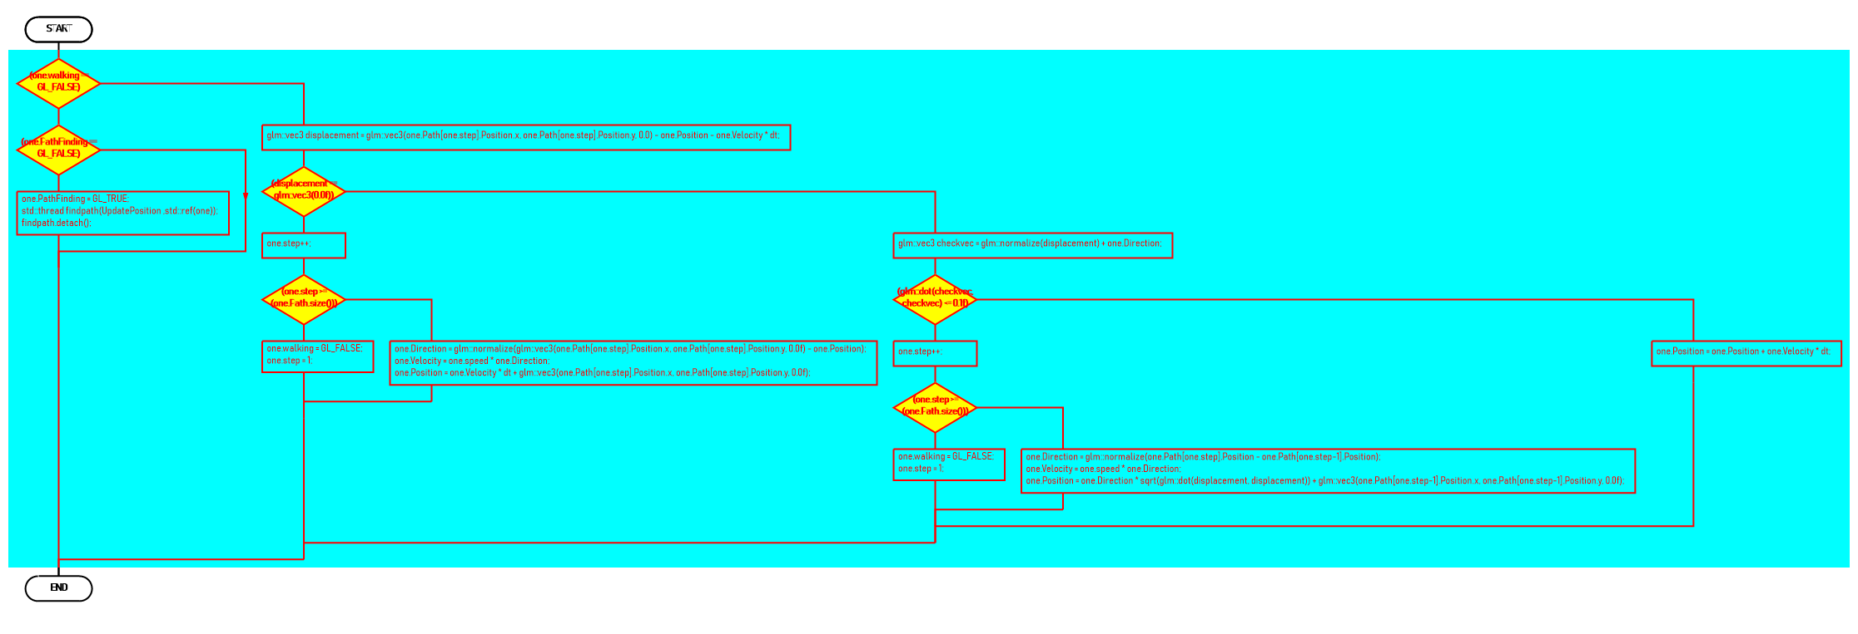
Design
Over all the flowchart of this function.
NPC
Running along the way

Slide 15
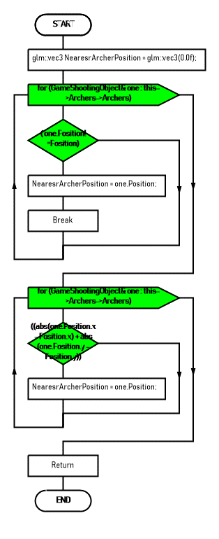
Design
NPC
Running along the way
Over all the flowchart of this function.
Need to create a new thread to improve the performance while Breadth First Search
The function that thread calls:

Slide 16
3
Implementation

Slide 17
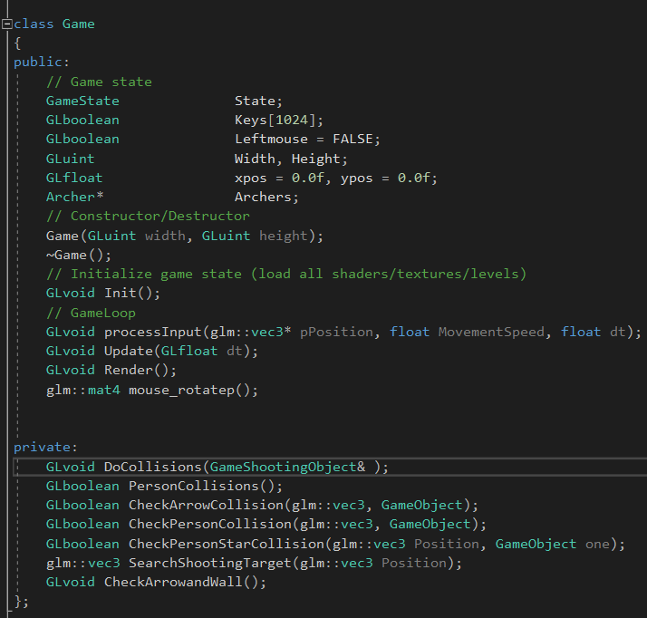
The Game Class
Implementation

Slide 18
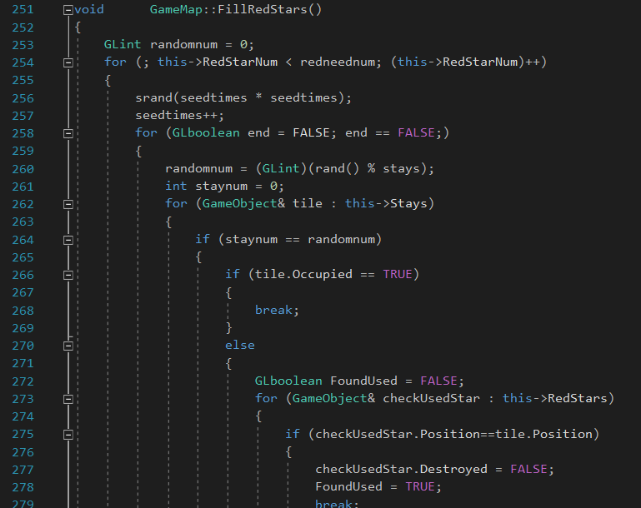
Implementation
Generate stars randomly

Slide 19
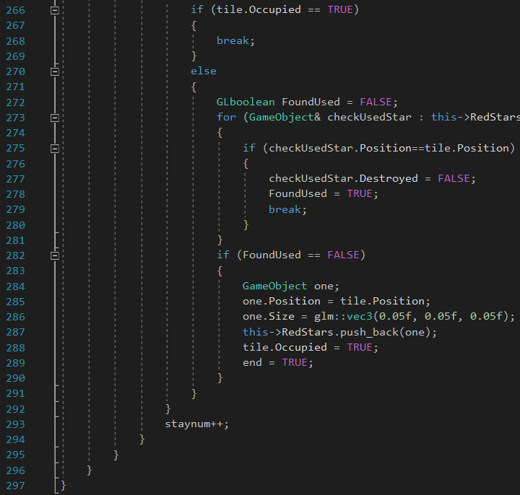
Implementation
Generate stars randomly

Slide 20
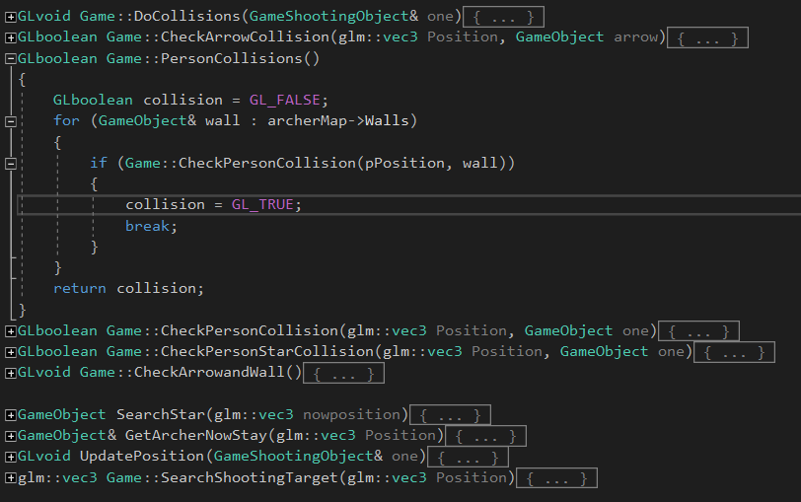
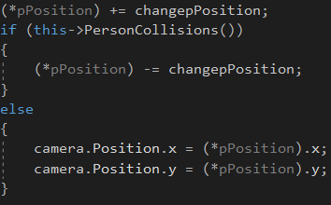
Implementation
Collison

Slide 21
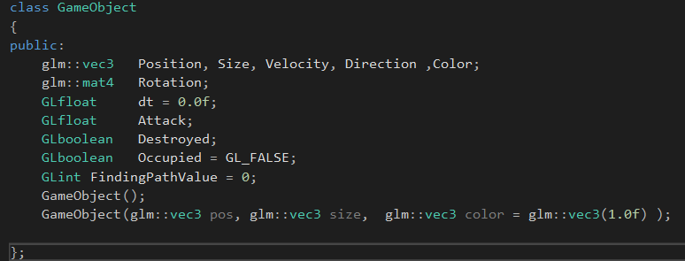
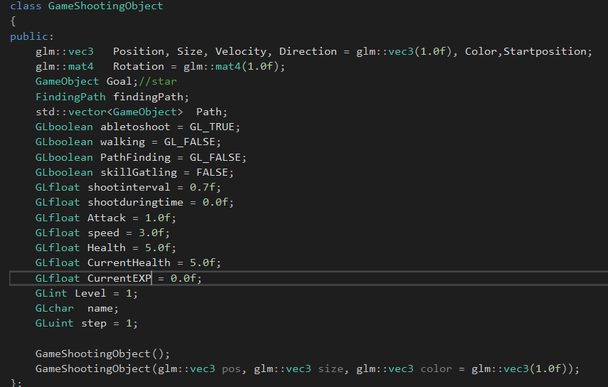
NPC Running along the way
Implementation
class GameObject
{
public:
glm::vec3 Position, Size;
glm::mat4 Rotation;
GLfloat dt = 0.0f;
GLboolean Destroyed;
GLboolean Occupied = GL_FALSE;
GameObject();
GameObject(glm::vec3 pos, glm::vec3 size, glm::vec3 color = glm::vec3(1.0f) );
…
};
class GameShootingObject
{
public:
glm::vec3 Position, Velocity, Direction = glm::vec3(1.0f);
GameObject Goal;//star
FindingPath findingPath;
std::vector<GameObject> Path;
GLboolean abletoshoot = GL_TRUE;
GLboolean walking = GL_FALSE;
GLfloat speed = 3.0f;
GLuint step = 1;
…
};

Slide 22
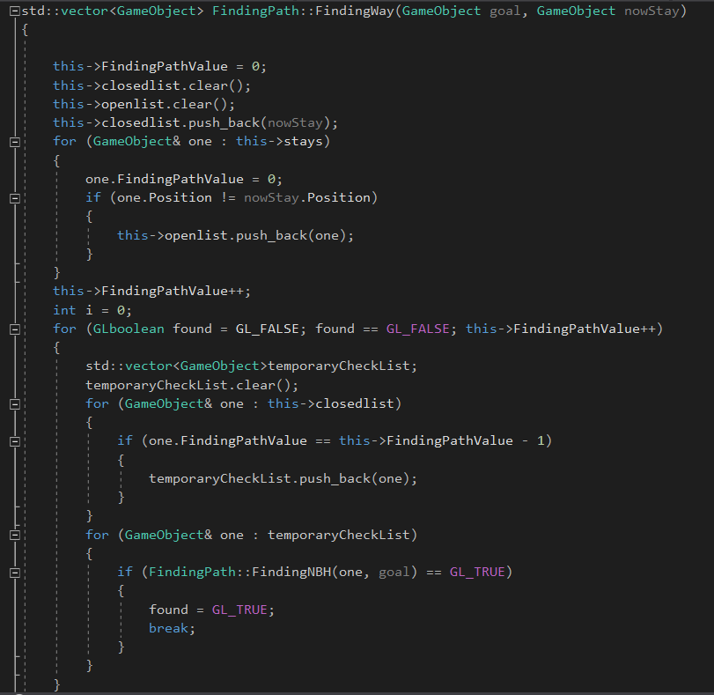
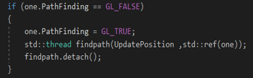
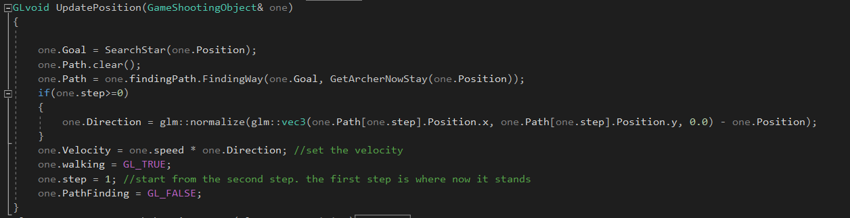
Implementation
NPC Running along the way
Board First Search.
(just for a quick look)
multiple threads

Slide 23
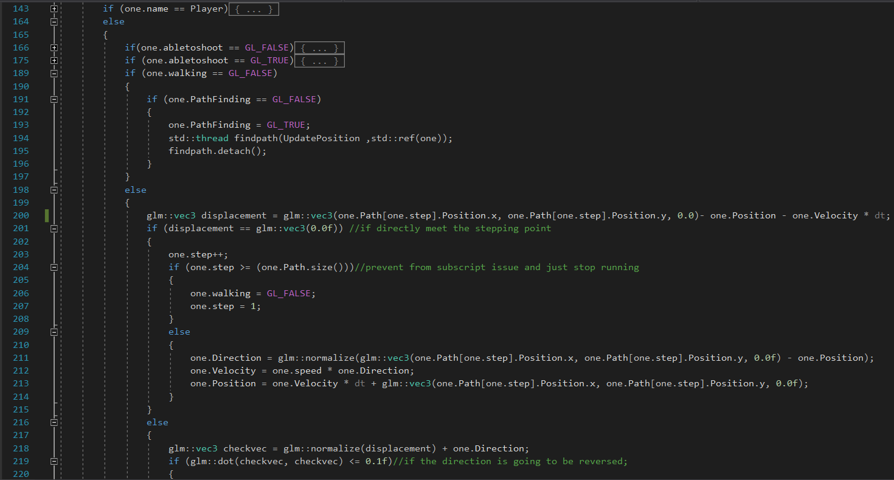
Implementation
Here it uses multiple threads
NPC Running along the way

Slide 24
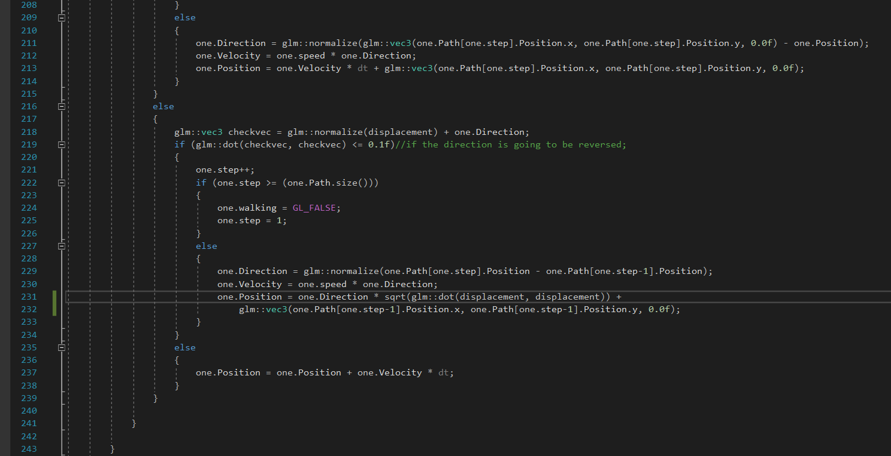
Implementation
NPC Running along the way

Slide 25
4
Test

Slide 27

Thanks

